Slide 1
Course Managment System
SlideMake.com

Slide 2

Introduction to Course Management Systems
A Course Management System is an online platform designed to facilitate educational courses and training programs.
It provides tools for content management, communication, and assessment.
CMS platforms help streamline the learning experience for both instructors and students.
Notes:
Image source: https://www.slidemake.com

Slide 3
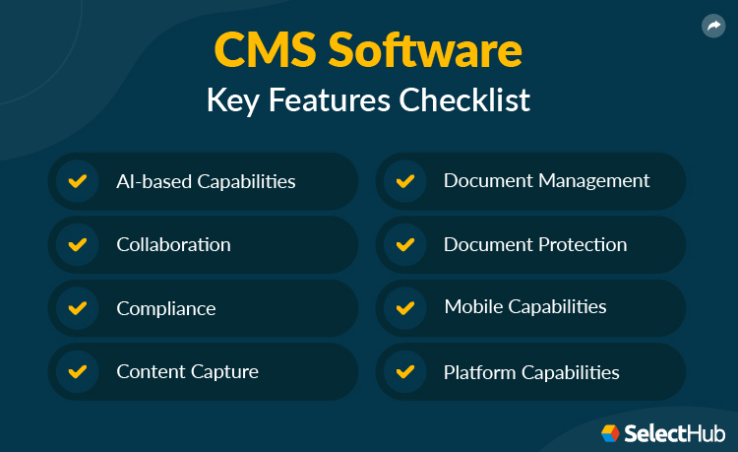
Key Features of a CMS
Course content can be easily uploaded, organized, and updated by instructors.
Communication tools such as forums, messaging, and announcements enhance interaction.
Assessment features like quizzes and grading systems allow for effective student evaluation.
Notes:
Image source: https://www.selecthub.com

Slide 4

Benefits for Instructors
Instructors can save time on administrative tasks, allowing them to focus on teaching.
The ability to track student progress and engagement helps tailor instruction to individual needs.
Flexibility in course delivery enables instructors to reach a wider audience.
Notes:
Image source: https://www.liveabout.com

Slide 5

Benefits for Students
Students enjoy easy access to course materials and resources from anywhere with an internet connection.
The interactive features of a CMS promote active learning and collaboration.
Timely feedback on assessments helps students understand their progress and areas for improvement.
Notes:
Image source: https://www.atebits.com

Slide 6
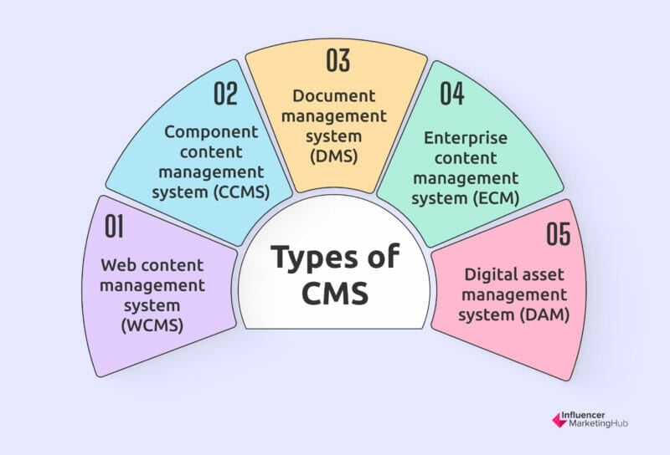
Popular Course Management Systems
Some of the most widely used CMS platforms include Moodle, Canvas, and Blackboard.
Each platform offers unique features and customization options to suit different educational needs.
Institutions often choose a CMS based on their specific requirements, budget, and user preferences.
Notes:
Image source: https://influencermarketinghub.com

Slide 7

Challenges in Implementing a CMS
Faculty resistance to adopting new technologies can hinder successful implementation.
Technical issues and limited IT support can create barriers to effective usage.
Ensuring student engagement and participation in an online environment remains a challenge.
Notes:
Image source: https://www.mentoringcomplete.com

Slide 8

Future Trends in Course Management Systems
The integration of artificial intelligence is expected to personalize the learning experience.
Increasing mobile accessibility will allow students to engage with courses on various devices.
Enhanced analytics tools will provide deeper insights into student performance and learning outcomes.
Notes:
Image source: https://datasciencedojo.com

Slide 9
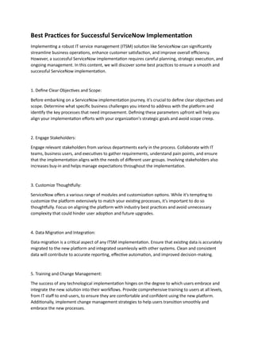
Conclusion and Best Practices
Implementing a CMS can significantly enhance the educational experience when done thoughtfully.
Regular training for instructors and students can improve adoption and effective use of the system.
Continuous evaluation and feedback will help institutions evolve their CMS to meet changing needs.
Feel free to adjust any of the content or structure as necessary!
Notes:
Image source: https://image.slidesharecdn.com

